Slide 1
Text Mining
Independent Course Study
Under the guidance of
Prof. Ranganathan Chandraskaren

Slide 2
Text Mining
Problem Statement :Classify tweets into categories such as Health , General Information
Data Set: Collected through web-scraping
Twitter API is used widely but limitation of Twitter API is that you can only collect upto a few thousand tweets.
Another limitation of twitter API is that you can’t extract all the information that is on the website
Tweets were only collected for Health institutions. There are 790 health institutions or handles.

Slide 3
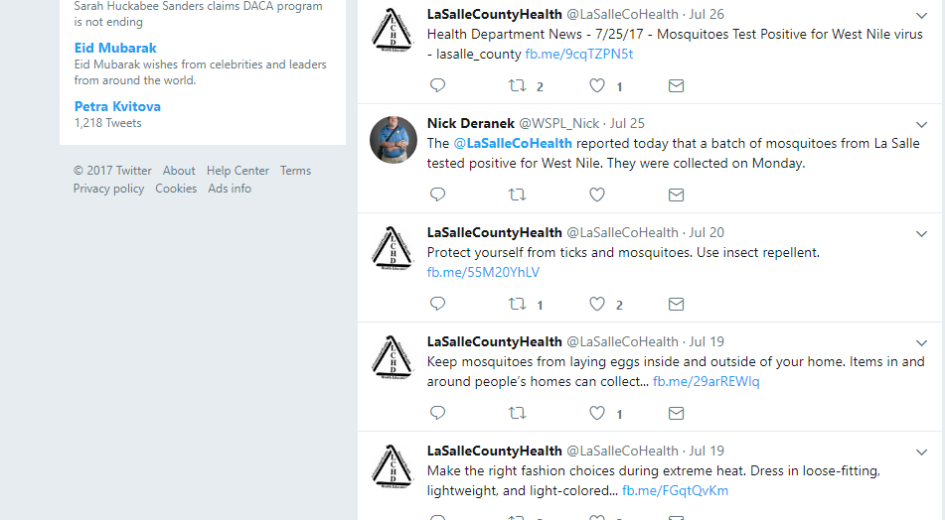
How the twitter website looks like ?
Twitter Name
Twitter Handle
Tweet

Slide 4
Web scraper
Web scraper was built using R. Package used is Rselenium*
https://drive.google.com/drive/folders/0Bzq4aAyBiuFQdHd0Y2JobmhjY1k
Rselenium is based on Selenium server and automates the web browser and takes control over it .You can then specify how you want to interact with the web browser by specifying the action e.g. scrolling, pressing the end key or pressing some specific button on the website
*I did web scraping using R. Earlier teams did it using Java and Python

Slide 5
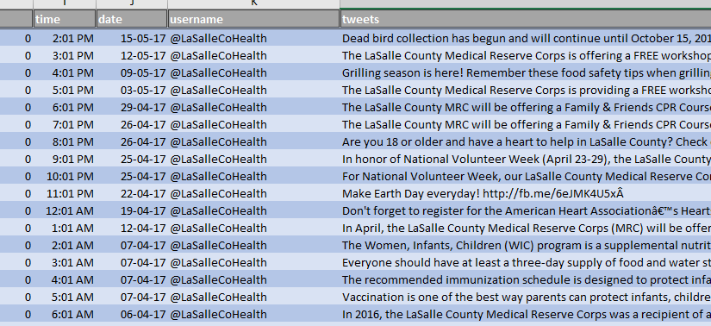
How the collected data looks like ?
https://drive.google.com/drive/folders/0B-x4pbFFhIICWmdvWnBwX1VwZzA

Slide 6
Text Cleaning
Example Tweet :
Don't forget to register for the American Heart Associationâ€™s HeartsaverÂ® First Aid Training offered by the...http://fb.me/6PjnRWaMAÂ
Steps taken to clean tweet
Tweets can be cleaned using the “tm” package in R . The functions are as follows
removeNumbers
removePunctuation
Stopwords
removeWords
stripWhitespace
stemDocument

Slide 7
Text Cleaning
However if one wants more control over the cleaning of the data. For this purpose regex expressions can be used
Punctuation replacement: LaSalletwe<-gsub(pattern = "\\W",replacement = " ",LaSalletwe)
Digits replacement: LaSalletwe<-gsub(pattern="\\d",replacement = "",LaSalletwe)
To remove a single letter: LaSalletwe<-gsub(pattern="\\b[A-z]\\b{1}",replace="",LaSalletwe)
The list of stopwords* can be modified in the English.dat file which can be opened. The stopwords can be created for any language in R. It can be helpful for instance in cities like Chicago where people speak languages like Spanish
*Changed the English.dat file in retrospective manner.

Slide 8
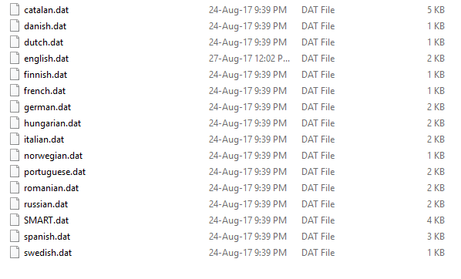
Text Cleaning
English.dat file can be changed for stopwords

Slide 9
Topic Modelling
Topic Modelling:
Classify documents using topic models.
Get themes from documents
Get topic distributions from corpus
Get word distributions within topics
A technique which is popular is known as Latent Dirichlet allocation(LDA) was used to find the topic distributions within documents.
Various versions of LDA like sLDA(supervised), Gibbs sampling are also present and may be used interchangeably depending on the goals.

Slide 10
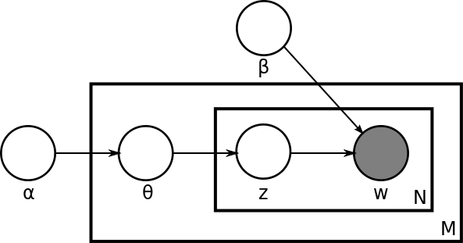
Topic Modelling
N is the number of words in a document
M is the number of documents
α is the parameter of the Dirichlet prior on the per-document topic distributions,
β is the parameter of the Dirichlet prior on the per-topic word distribution,
Ɵ is the topic distribution for document m,
ψ is the word distribution for topic k,
z is the topic for the n-th word in document m, and
w is the specific word.

Slide 11
Topic Modelling
LDA gives the themes of the document or the corpus. LDA can be used in various ways.
On a single tweet
On a single handle
On the entire corpus

Slide 12
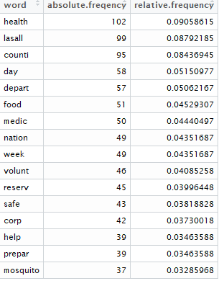
Word Frequency -On a single handle
We are illustrating by taking example of LaSalleCoHealth
Total no of Observations: 691
Total no of words after data cleaning: 1126 observations
Top 16 words which occurs most in their tweet are

Slide 13
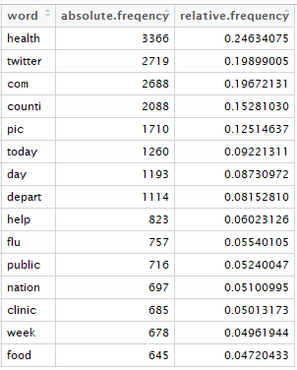
Word Frequency-On the corpus
Total no of Observations: 16449
Total no of words after data cleaning: 13665 observations

